Slide 1
Flux over the Wire
ReactJS Paris Meetup #1
Elie Rotenberg <elie@rotenberg.io>

Slide 2
About me – personal branding™
CTO Webedia Gaming
jeuxvideo.com | millenium.org | fr.ign.com
@elierotenberg 
elierotenberg 
blog.rotenberg.io 
elie@rotenberg.io →
Some repos I’m proud of:
nexus-flux | react-nexus | remutable | react-animate | es6-starterkit

Slide 3

App state
Global state: state updated by DOM/HTML APIs
Window size, mouse/scroll position, location URL, clocks…

Slide 4
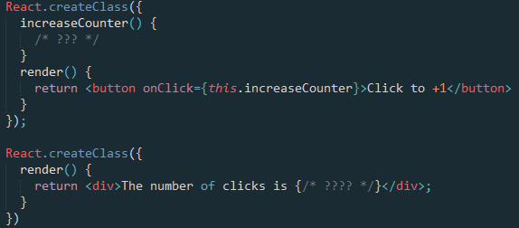
App state
Shared state: state shared by multiple components
User login, navigation state, non-local business logic

Slide 5
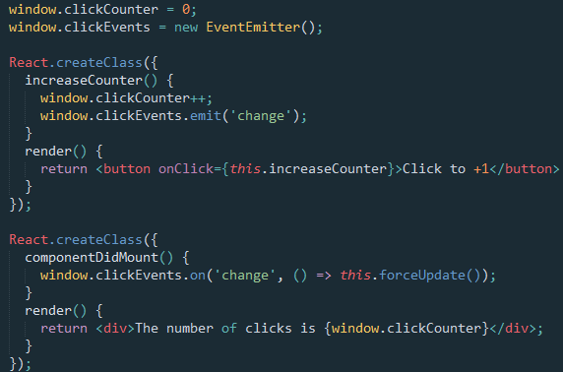
App State in React – using globals
Use global variables
Re-render on change events

Slide 6
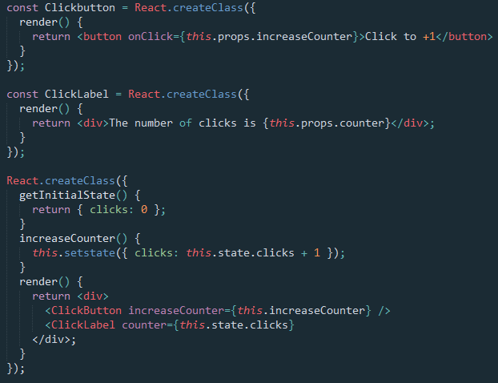
App State in React – passing down props
Pass down getters and setters as props

Slide 7
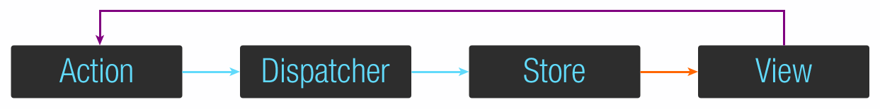
App State Management with Flux
Implicit global
One-way data flow
Stores represent read-only values that might be updated
Actions represent fire-and-forget intents
Re-render whenever a depended Store is updated

Slide 8
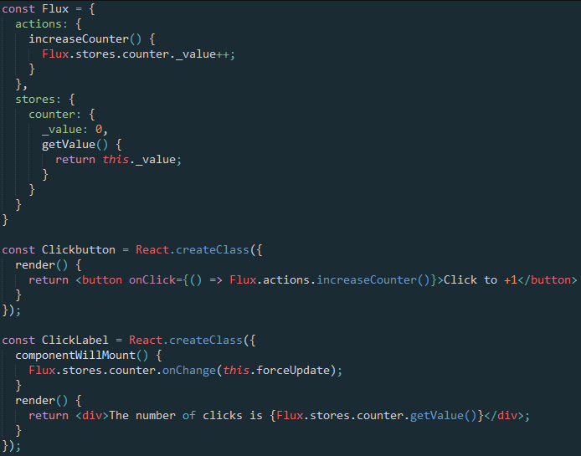
App State Management with Flux

Slide 9
App State Management with Flux
Goal:
share state between multiple components
Problems:
actually expose the state
avoid shared mutable state
re-render when and only when required
Solution: Flux
expose state to all components
encapsulate state in a one-way flow
stores are read-only observers
actions are fire & forget intents

Slide 10
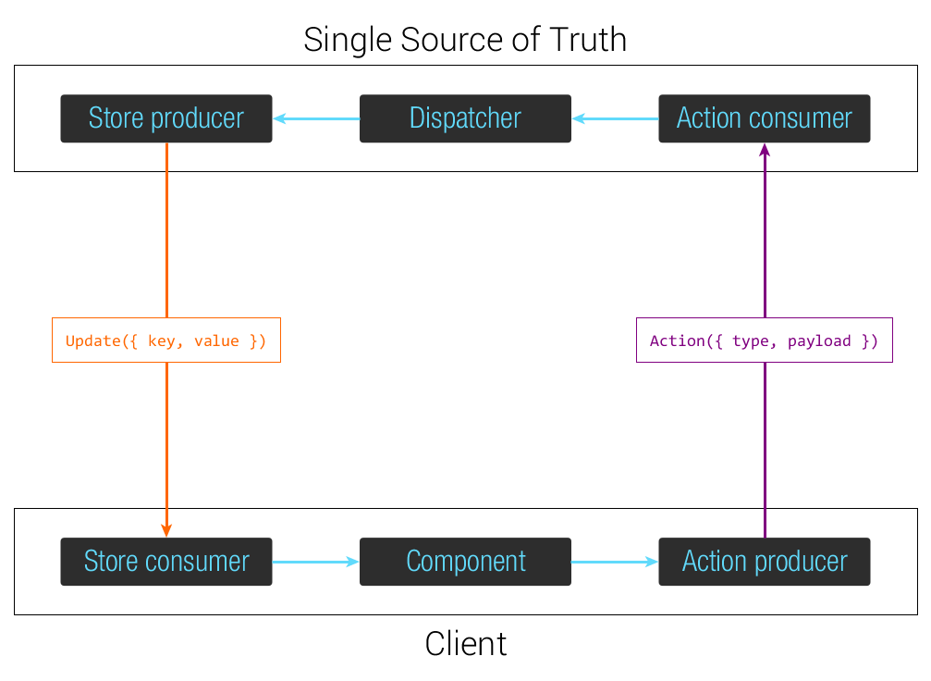
Nexus Flux

Slide 11
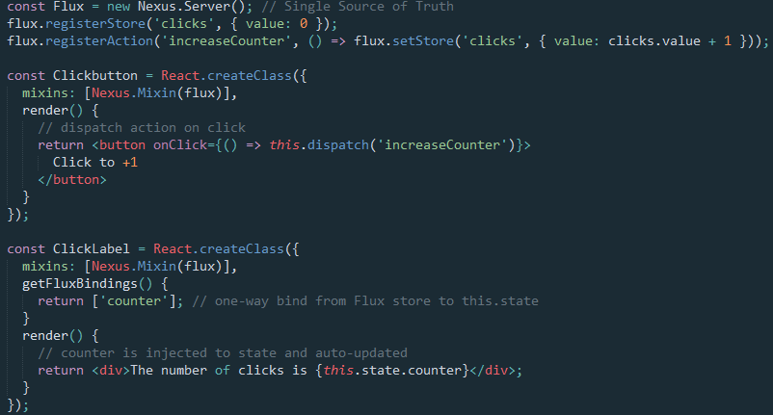
Nexus Flux

Slide 12
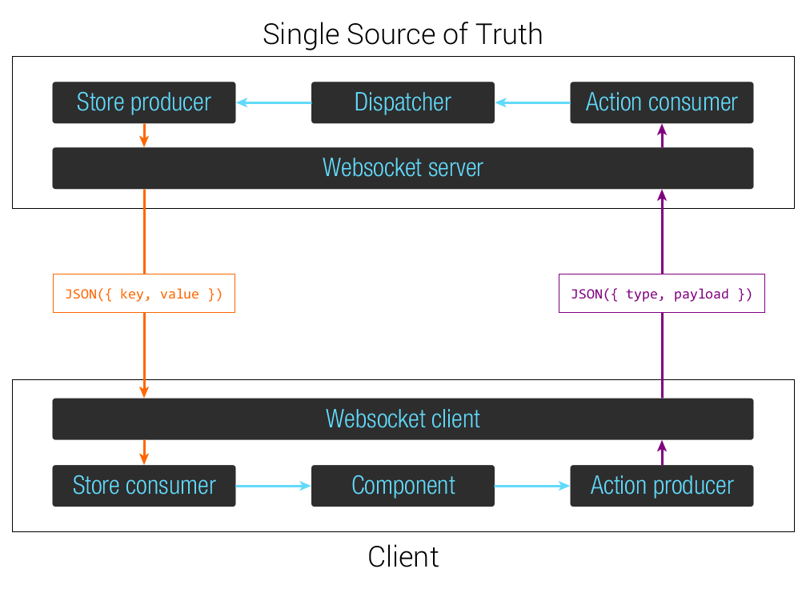
Flux over the Wire

Slide 13
Flux over the Wire
Implements the Nexus Flux API
The Single Source of Truth is in the datacenter
The Client is in the browser
Actions are encoded in C2S Websocket frames/POST requests
Stores are updated in S2C Websocket frames/exposed as GET

Slide 14
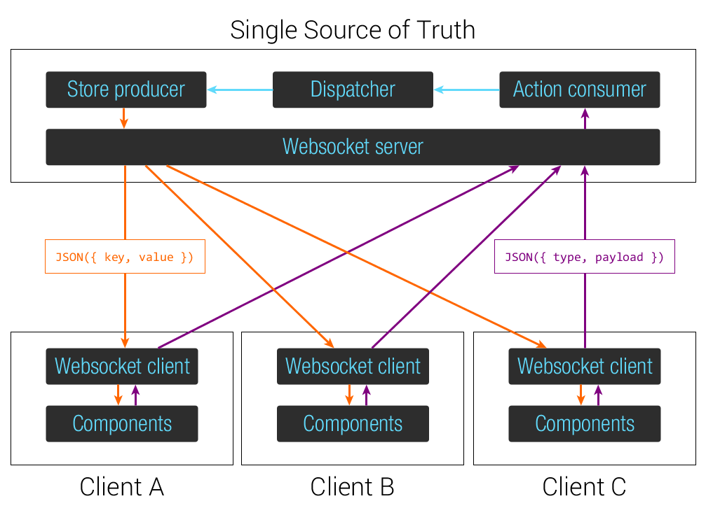
Flux over the Wire

Slide 15
Flux over the Wire
Shared state between the server and the client…
And every other connected client.
Enables real-time first app design
Gracefully degrade to non-real-time

Slide 16
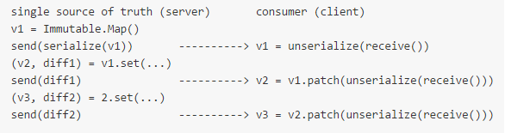
remutable
Record & serialize mutations on the server
Transmis the update diff over the wire
Unserialize & apply mutations on the client

Slide 17
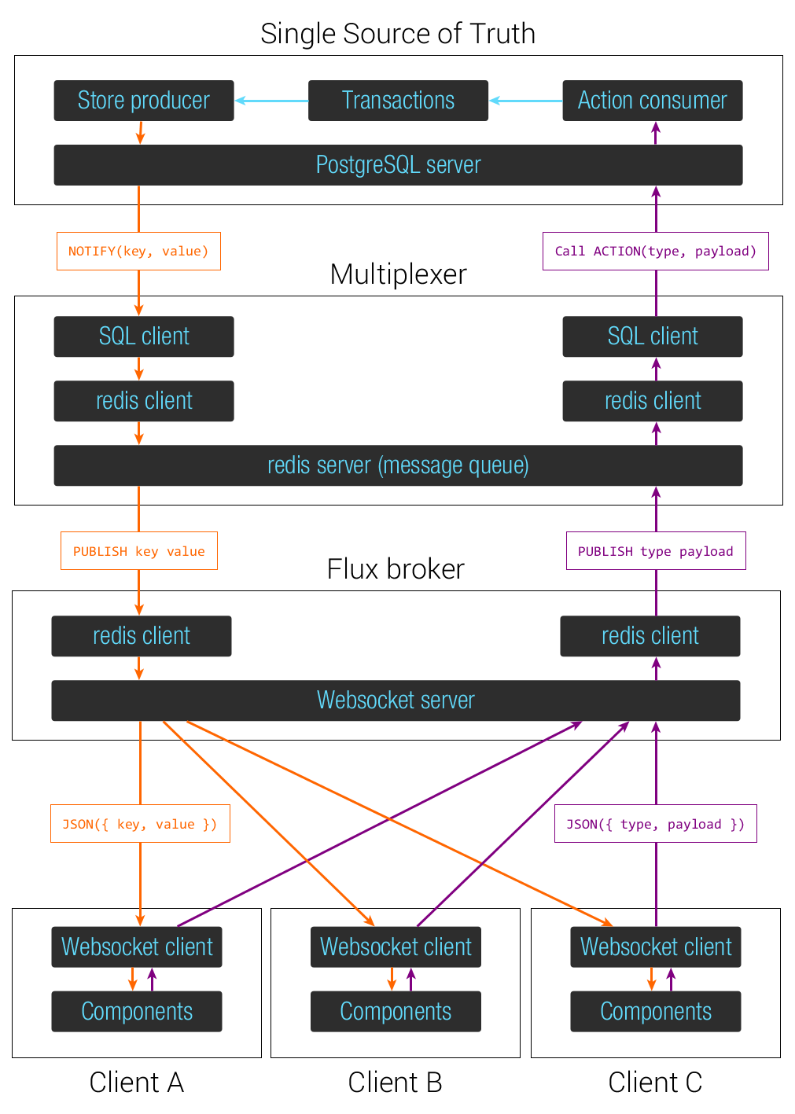
Million user webchat with Nexus Flux

Slide 18
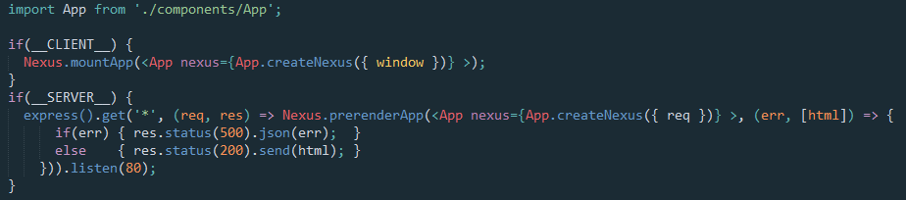
Server side rendering with React Nexus

Slide 19
Demo!

Slide 20
Conclusion
React = 
React + Flux =  
React + Flux + Nexus =   
React + Flux + Nexus + Flux over the Wire =    
React + Flux + Nexus + Flux over the Wire + React Nexus =     

Slide 21
About me – personal branding™
CTO Webedia Gaming
jeuxvideo.com | millenium.org | fr.ign.com
@elierotenberg 
elierotenberg 
blog.rotenberg.io 
elie@rotenberg.io →
Some repos I’m proud of:
nexus-flux | react-nexus | remutable | react-animate | es6-starterkit

